Slide 1

Unit -2
Networking Commands

Slide 2
What is networking commands?
Networking commands are used for to check network connectivity, path identification, DNS request resolution, and remote connection setup for testing.
These network settings often run into issues and affect the system’s working. Such network problems can be resolved using ‘networking commands.
These commands are specifically designed to solve the troubleshoot network problems with minimum complexity using the windows command prompt tool.

Slide 3
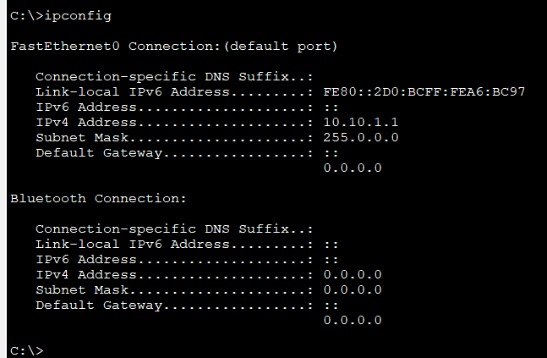
What is IPCONFIG Command ?
The IPCONFIG network command provides a comprehensive view of information regarding the IP address configuration of the device we are currently working on.
1. Ipconfig -

Slide 4
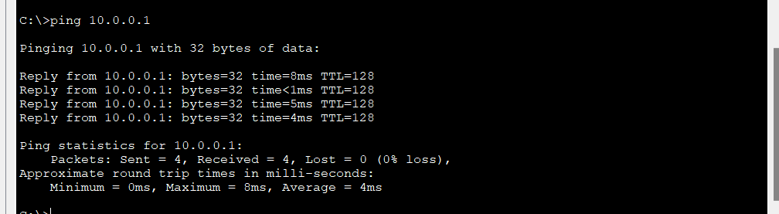
What is Ping command?
A ping (Packet Internet or Inter-Network Groper) is a basic Internet program that allows a user to test and verify if a particular destination IP address exists and can accept requests in computer network administration. How to give ping command .

Slide 5
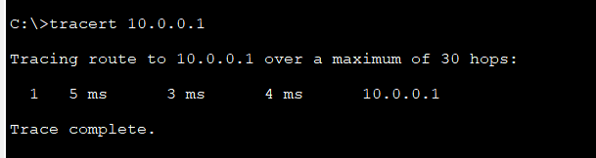
What is Tracert?
The Traceroute command (tracert) is a utility designed for displaying the time it takes for a packet of information to travel between a local computer and a destination IP address or domain.

Slide 6
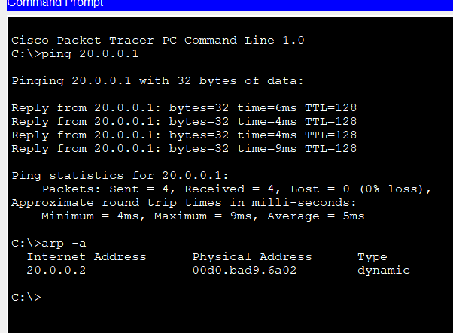
What is Arp command ?
The arp command displays and modifies the Internet-to-adapter address translation tables used by the Address in Networks and communication management. The arp command displays the current ARP entry for the host specified by the Host Name variable.

Slide 7
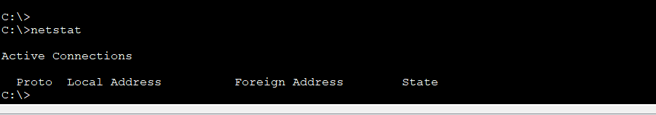
What is Netstat ?
The network statistics ( netstat ) command is a networking tool used for troubleshooting and configuration, that can also serve as a monitoring tool for connections over the network.

Slide 8
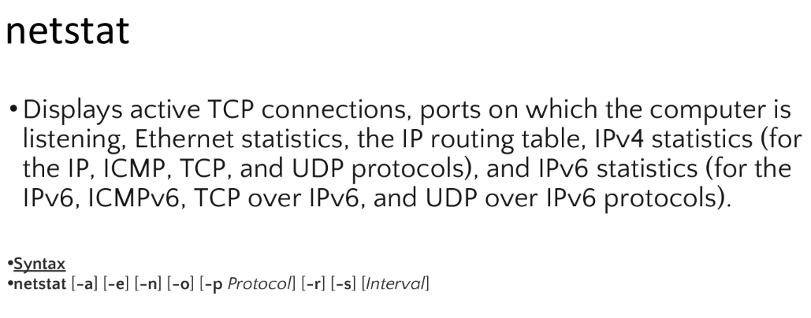
Netstat with syntax and parameters .

Slide 9
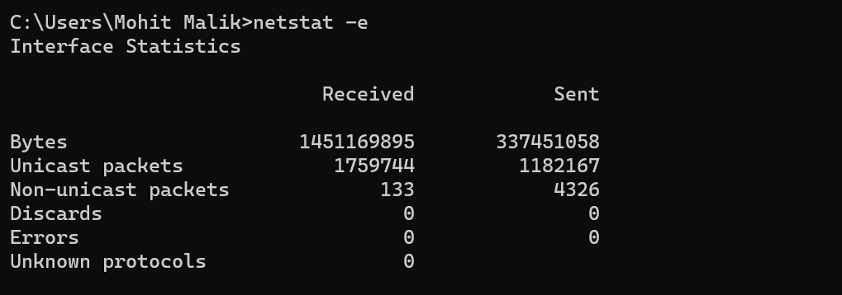
Output of netstat parameters -e

Slide 10
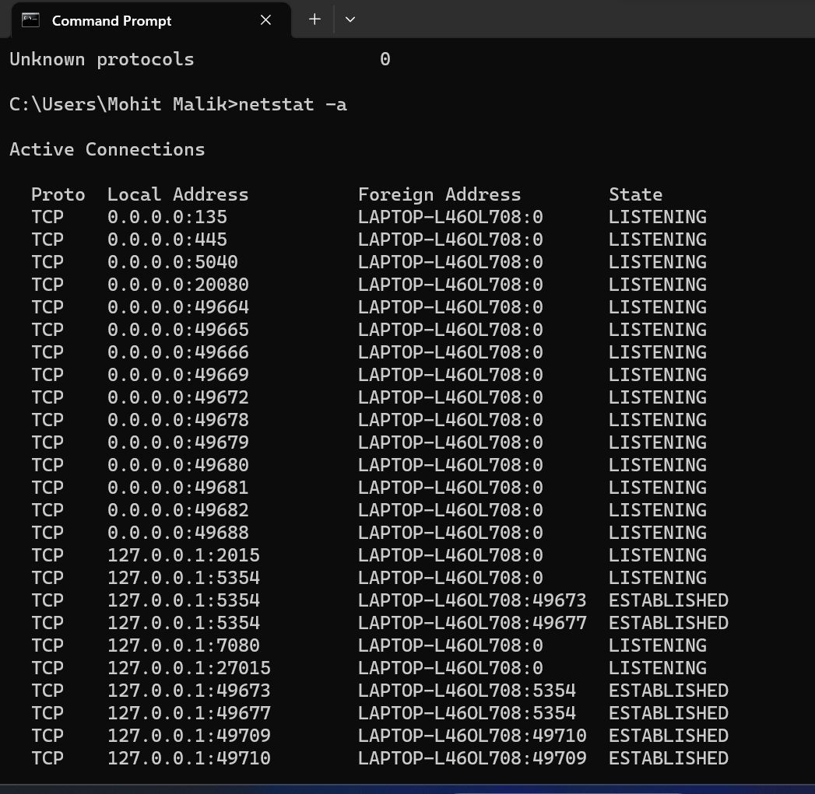
Output of netstat –a to see TCP connections.

Slide 11
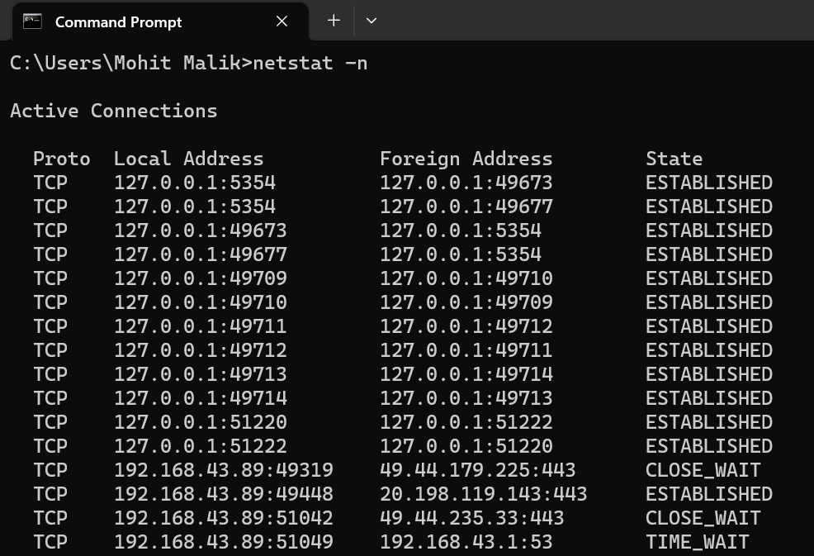
Output netstat -n

Slide 12
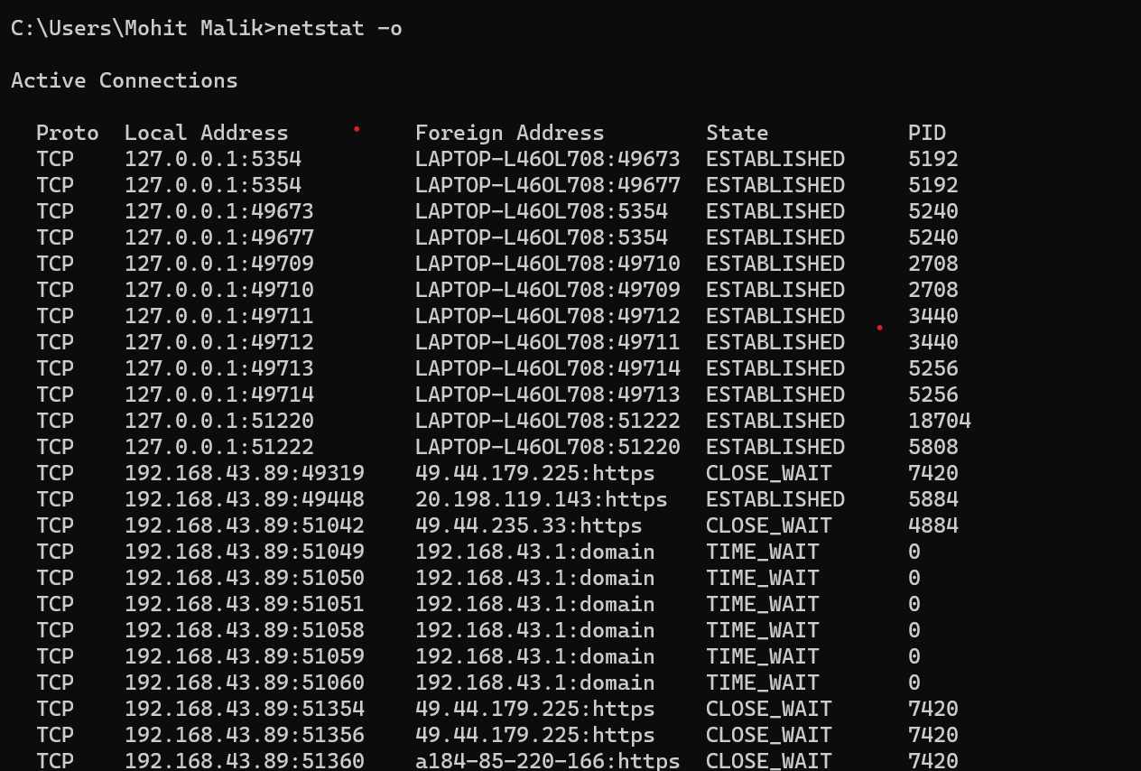
Output of netstat -o

Slide 13
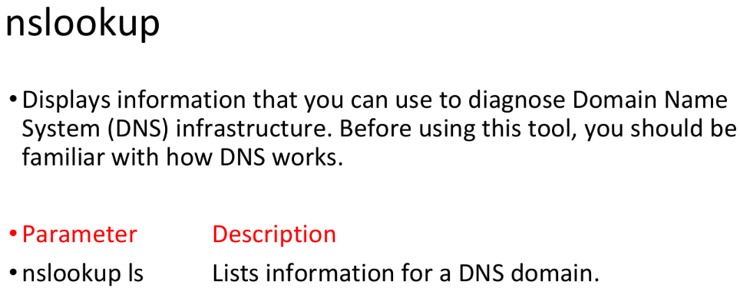
Nslookup

Slide 14
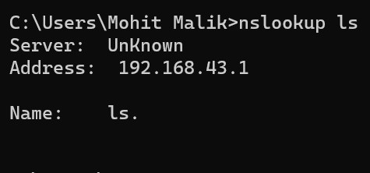
Nslookup ls

Slide 15
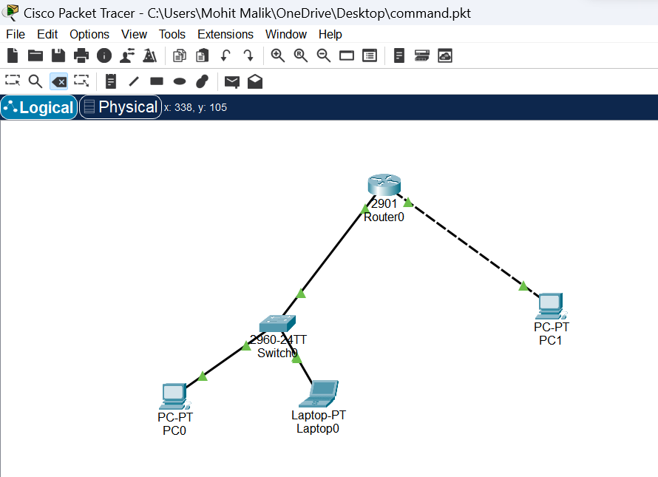
Implementation of networking commands in cisco packet tracer.

Slide 16
Thanks

